Slide 1

AI Programming Monthly Briefing
July 2026
Prepared by: Li Long | New Team Member
Notes:
Good morning. I'm Li Long. This is a ~10-minute briefing on AI programming: where coding models stand in July 2026, how we can use them effectively on the team, and what I recommend we watch next. I'll keep it practical and leave time for questions.

Slide 2

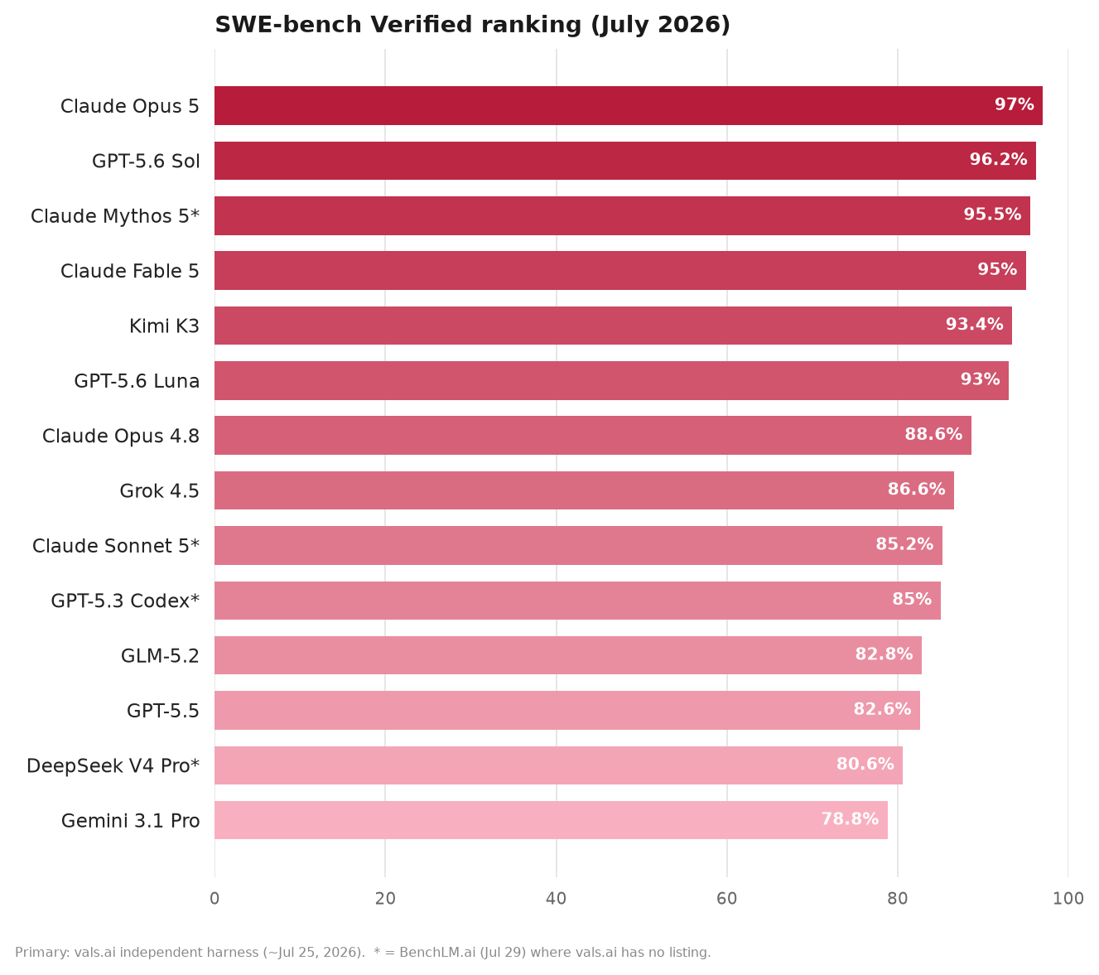
AI Coding Models: Where We Stand (July 2026)
Focus | About 1 year ago | July 2026 (now)
Role in the team | Helpful intern: good at snippets; needed step-by-step prompts. | Senior pair-programmer: takes goals, plans, and patches across a repo.
Frontier leaders | GPT-4o / Claude 3.5 era - strong chat, weaker on full GitHub issues. | Claude Opus 5 / Mythos 5 / Fable 5 and GPT-5.6 Sol lead (~95-97%).
Open & value tier | Open models clearly behind closed frontier on hard coding tasks. | Kimi K3 ~93%; DeepSeek V4 Pro ~81%; Gemini 3.1 Pro ~79% (vals.ai).
Takeaway: Top tier is crowded (Opus 5, GPT-5.6 Sol, Fable/Mythos 5). Pick by task - and always brief with goals + review criteria.
Notes:
(~3 min) Ranking: primarily vals.ai independent SWE-bench Verified (~Jul 25, 2026); starred names use BenchLM when vals.ai has no listing. Claude Opus 5 ~97%, GPT-5.6 Sol 96.2%, Mythos/Fable ~95%, Kimi K3 93.4%, GPT-5.6 Luna 93%, GPT-5.5 82.6%, DeepSeek V4 Pro ~80.6%, Gemini 3.1 Pro 78.8%. Left-table models all appear on the right chart. Best model depends on the job - backend bugs vs UI (Kimi strong on frontend arena).

Slide 3





Two Practices That Make AI Useful at Work
1. Build a reusable Skill library
2. Guide AI with design patterns (not vibe coding)
Save winning prompts as SKILL.md (task + context + checks). Turn one person's win into the team's default playbook.
Ask for a pattern up front. AI then produces code we can extend — not a one-off script that breaks on the next change.
Key: Name the pattern + interfaces. Example: Strategy for payments.
Clear task
What to build, and what 'done' means.
Best prompt
Keep the exact wording that worked.
Weak: "Write credit-card payment code." -> rigid, hard to extend.
Better: "Implement payments with Strategy (interface + card/PayPal classes)."
Project context
Attach code, APIs, and constraints.
Validation
How we verify: tests, review, demo.
Result: New payment methods plug in without rewriting existing code — easier review and safer changes.
Checklist: inputs/outputs | quality rules | project context | who reviews.
Notes:
(~3.5 min) Two habits I recommend we institutionalize. First, a Skill library: when a prompt works, capture it as SKILL.md — task, best prompt, context files, and how we validate. Second, stop 'vibe coding' for anything that will live in production: name a design pattern so the model designs for change. Simple payment example: Strategy pattern vs a hardcoded credit-card function. This keeps AI output reviewable and maintainable for the team.

Slide 4







Outlook & Recommendations
What is coming next
What I recommend (team + my ramp-up)
Autonomous agents
Multi-step coding agents that open PRs with less hand-holding.
Write better briefs
Goal, constraints, Definition of Done — before opening the chat.
Judge with data
Track where AI helps (speed, defects) so we pick tools by evidence.
Multimodal workflows
Design mocks, logs, and video demos become first-class inputs.
Keep human ownership
I own design trade-offs, security, and stakeholder communication.
Learn in public
Share SKILL.md wins weekly; stay current on model releases.
Tight review loops
Models improve via tests & feedback; humans own architecture & risk.
Notes:
(~2.5 min) Looking ahead: agents will take longer coding threads; multimodal inputs (UI + logs) will be normal; quality still depends on our tests and review. As a new member, my plan is practical: write clearer briefs, measure where AI actually helps, never outsource architecture or risk judgment, and contribute Skills back to the team. Happy to align this with how you want the team to adopt AI tooling.

Slide 5

Thank you
Q&A
Happy to discuss rankings, Skills, or a pilot on our next feature.
Notes:
(~0.5 min + Q&A) Thanks for the time. I'm happy to go deeper on the benchmark, draft a first Skill template for the team, or help trial one model on a real ticket.

